Slide 1
Image Component Labeling
Whitney Wood, Khoi Phan, and Nikki Pruitt

Slide 2
Problem
Given an m X m matrix with 0’s and 1’s indicating components of an image, group adjacent pixels labeled by 1. After grouping the pixels, give each group a label with a number other than 1.

Slide 3
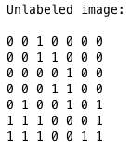
Given Image

Slide 4
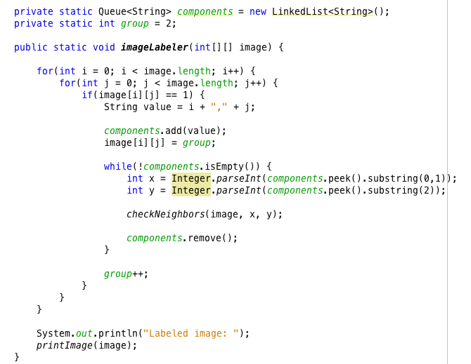

Slide 5
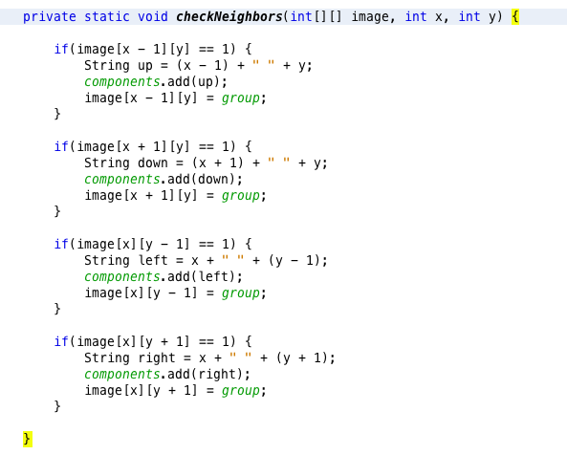

Slide 6
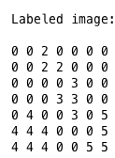
Labeled Image

